Slide 1




Higher English
Information
*Rigour, Aspiration and Perseverance*
Article 29
The right to an education that develops your talents and abilities

Slide 2
What we expect in the faculty?
Rigour – If it is worth doing, then do it to the best of your ability
Aspiration – Always try to be the best version of yourself
Perseverance – never give up on yourself, because we never will

Slide 3
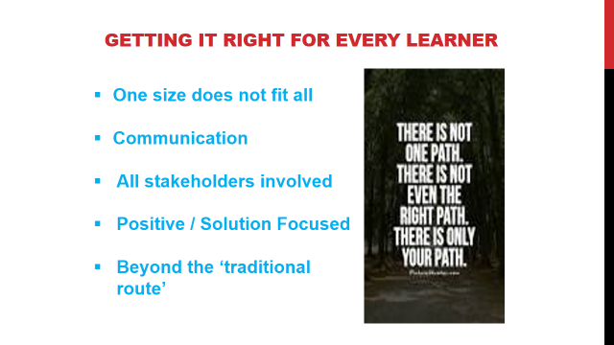

Slide 4
Higher Results 23/24
Result | A | B | C | D
(116 pupils) Percentage | 46 (40%) | 29 (25%) | 26 (22%) | 12 (10%)
NA
3 (3%)
*This means that there was an 87% pass rate for Higher with 65% of our pupils achieving an A or B grade* National average for an A-C grade across Scotland is 74.6%
23 Pupils achieved an SCQF Level 6 National Certificate in Communication and Literature

Slide 5
National 5 Results 23/24
Result | A | B | C | D
(156 pupils) Percentage | 63 (40%) | 42 (28%) | 24 (15%) | 14 (9%)
NA
13 (8%)
*This means that there was a 83% pass rate for N5 with 68% of our pupils achieving an A or B grade. *
National average for an A grade is 35.3% / Pupils that were struggling had N4 banked

Slide 6


Slide 7

S5 English
What are the options?
HIGHER
Nc Communication and literature

Slide 8
Course outline
Ruae (Paper 1) – Exam 30%
Critical Reading (Paper 2) – Exam 40% (Essay/set text)
Folio- External 30% (only one essay this year)

Slide 9

RUAE – 1hr 30mins
N5 – 1Hr
RUAE stands for Reading, Understanding, Analysis and Evaluation.
Pupils will be tested on their understanding of the passage, their analysis of language and evaluating how successful it has been in getting across the main ideas.
The RUAE paper will consist of 2 non-fiction passages.
They will both focus on the same topic but may express different views.

Slide 10

RUAE – 1hr 30mins
N5 – 1Hr
The majority of the questions will focus on passage one. The final question will ask the candidate to consider both passages (5 marks).
Pupils are encouraged to answer in bullet point form.
The big difference from N5 is that there are no longer marks awarded for quotes or references (still need to go through that process).
Higher average out of 30 = 15.8
N5 average out of 30 = 15.7

Slide 11

Critical Reading 1hr 30mins
This paper consists of two different sections – Scottish Set Text and Critical Essay
Both sections are worth 20% each
Candidates will spend roughly 45 mins on each section
Time management is a key skill for this paper
Higher average out of 40 = 22
N5 average out of 40 = 27.6

Slide 12

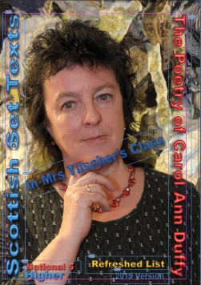
Scottish Set Text
Section one is Scottish set text – a study of Scottish literature.
The class teacher will have chosen one of the following options:
6 poems
3 short stories
A play
A novel.
They will have detailed notes and annotations for each poem in their possession.
They will receive one poem in the exam and the majority of questions will be based on this poem.

Slide 13

Scottish Set Text
The last question will always be worth 10 marks and it is the only time they must bring in evidence from the other poems. There is a set structure to answer this question and every pupil will have detailed notes explaining what is required.
The big difference between N5 and Higher is that candidates will no longer receive marks for references or quotes. All available marks are based on analysis.

Slide 14


Critical Essay
Section two is the critical essay of the exam.
Each candidate will study either a novel, play or short story. They will work though the text in detail and take notes on aspects like characterisation, theme, conflict etc They will also be given model examples of responses to the type of questions that arise in this section.
Candidates will be asked to choose one question from various different sections of questions. They must answer the questions under the genre of text they studied e.g. If they studied a play, then they must answer one of the questions from the Drama section.

Slide 15

Critical Essay
Candidates will have roughly 45 mins to write this essay. It is important that candidates practice writing essays within this time frame (unless they are entitled to extra time). This will give them every chance of writing a detailed and thorough response in the time allocated.

Slide 16

Folio
This is the coursework that is completed throughout the year and is usually submitted to the SQA before the Easter break to be marked.
Candidates can select between a Discursive/Persuasive or Reflective/Creative genre for their piece. Candidates usually have to submit two pieces but the SQA have removed one piece this year in response to the impact of COVID.
The class teacher can help each candidate plan their essay. The first draft will be written in class time with notes available. Staff will then feedback and mark one further draft of their work and provide support in how to improve their work.

Slide 17

Folio
The final piece should be no longer that 1,300 words. There is a 10% allowances above this, however we try to stick to the advertised word count as much as possible. There is no minimum word count but any piece that is less the 1,000 tends to be self-penalising in our experience.
The essay will be marked out of 15 marks. Due to the changes, this mark will then be doubled to give the candidate a percentage out of 30.
Please avoid any temptation to plagiarise. If the SQA suspect plagiarism has taken place you will be awarded zero for the folio. Avoid programmes like ChatGPT and Grammarly. If in doubt, leave it out!

Slide 18
Same course – big difference

Slide 19
“Higher English requires far more study and a greater understanding of the texts. It’s a big step up from NAT 5 in terms of the volume of content and the work that has to go in to pass”

Slide 20
“The best thing to do is ask for help when you need it – you’re not always going to get things first time around, and that's okay. If you try your best and ask questions you really can’t go wrong. Just make sure you use the help that’s out there for you”.

Slide 21
“I loved studying my text this year, it taught me important lessons about morals and values. For me, it was really important that I passed the final exam but this year in English, I have learned so much more than just exam skills.”

Slide 22
How can you help?

Slide 23



Above All Read
Now there are more ways than ever to access books: Kindle, iPhone, iPad, Audible, BorrowBox are just a few.
There really is no substitute for reading when it comes to advancing in English. Reading books develops learners’ vocabularies, their imaginations, and their ability to understand complex notions.

Slide 24
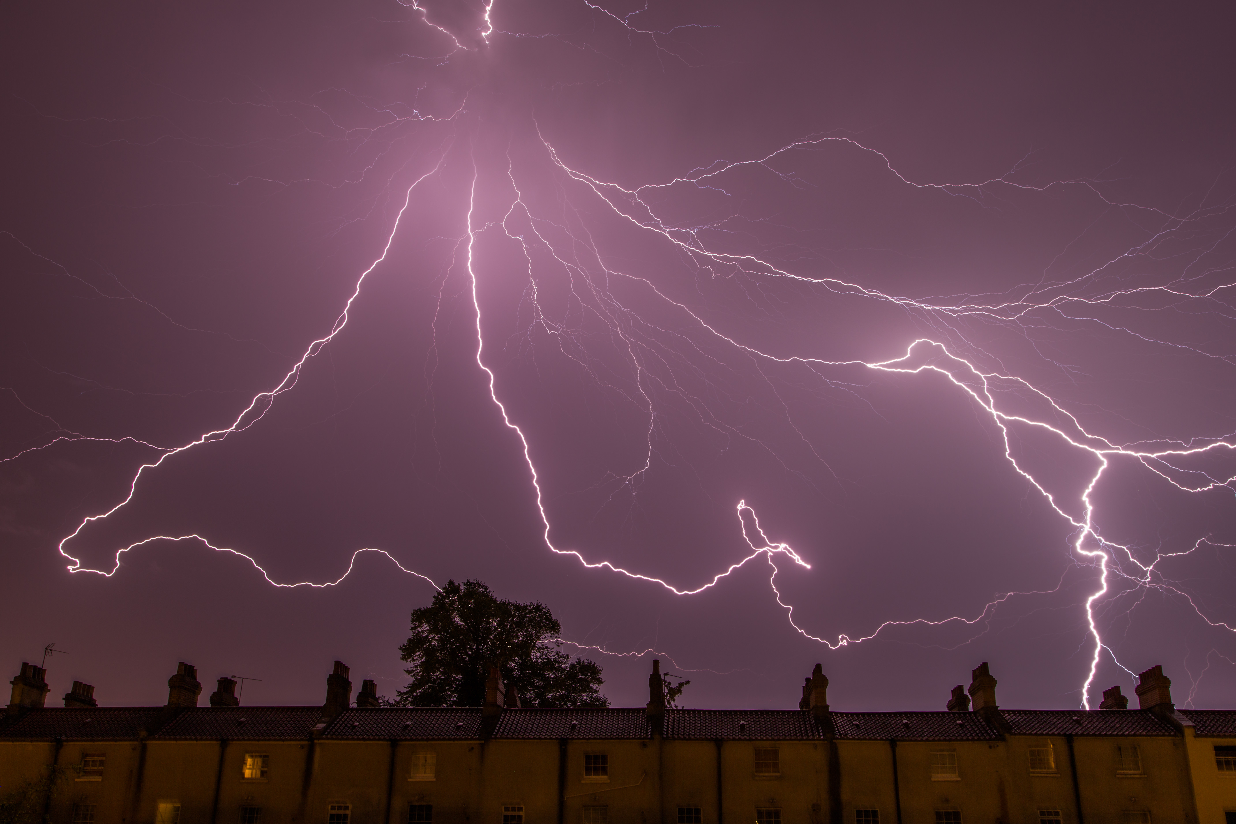



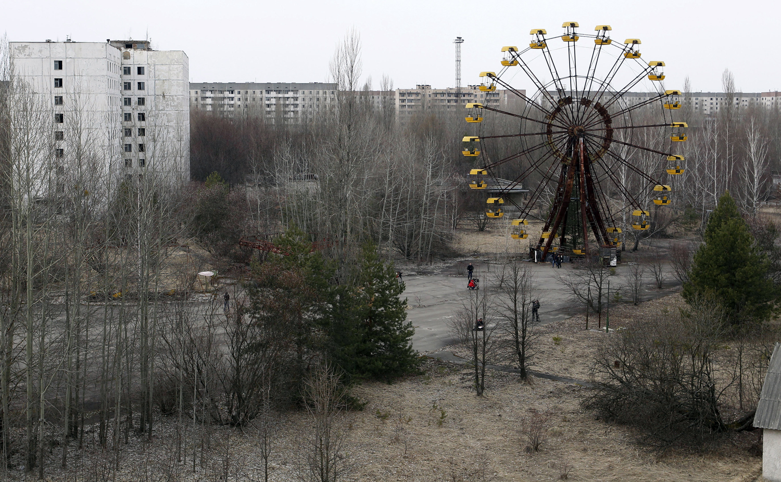

Inspiration
T.V. shows and films have fantastic characters, settings, and dialogue. These can be inspiring for learners and can positively influence their imagination. You can talk about the plot, themes and characters with your child.

Slide 25




Non-Fiction
One of the best ways to prepare for RUAE is to get used to reading and discussing newspaper articles. This will be the type of article that will be in the exams. Think about the topic being explored and the way the article has been constructed. Has it been successful?

Slide 26
Take an interest

Slide 27
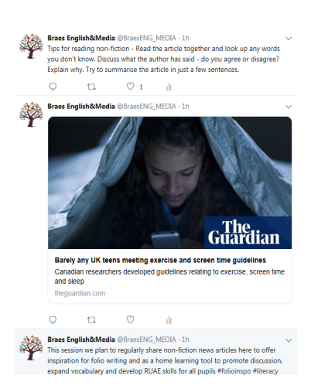
Twitter

Slide 28

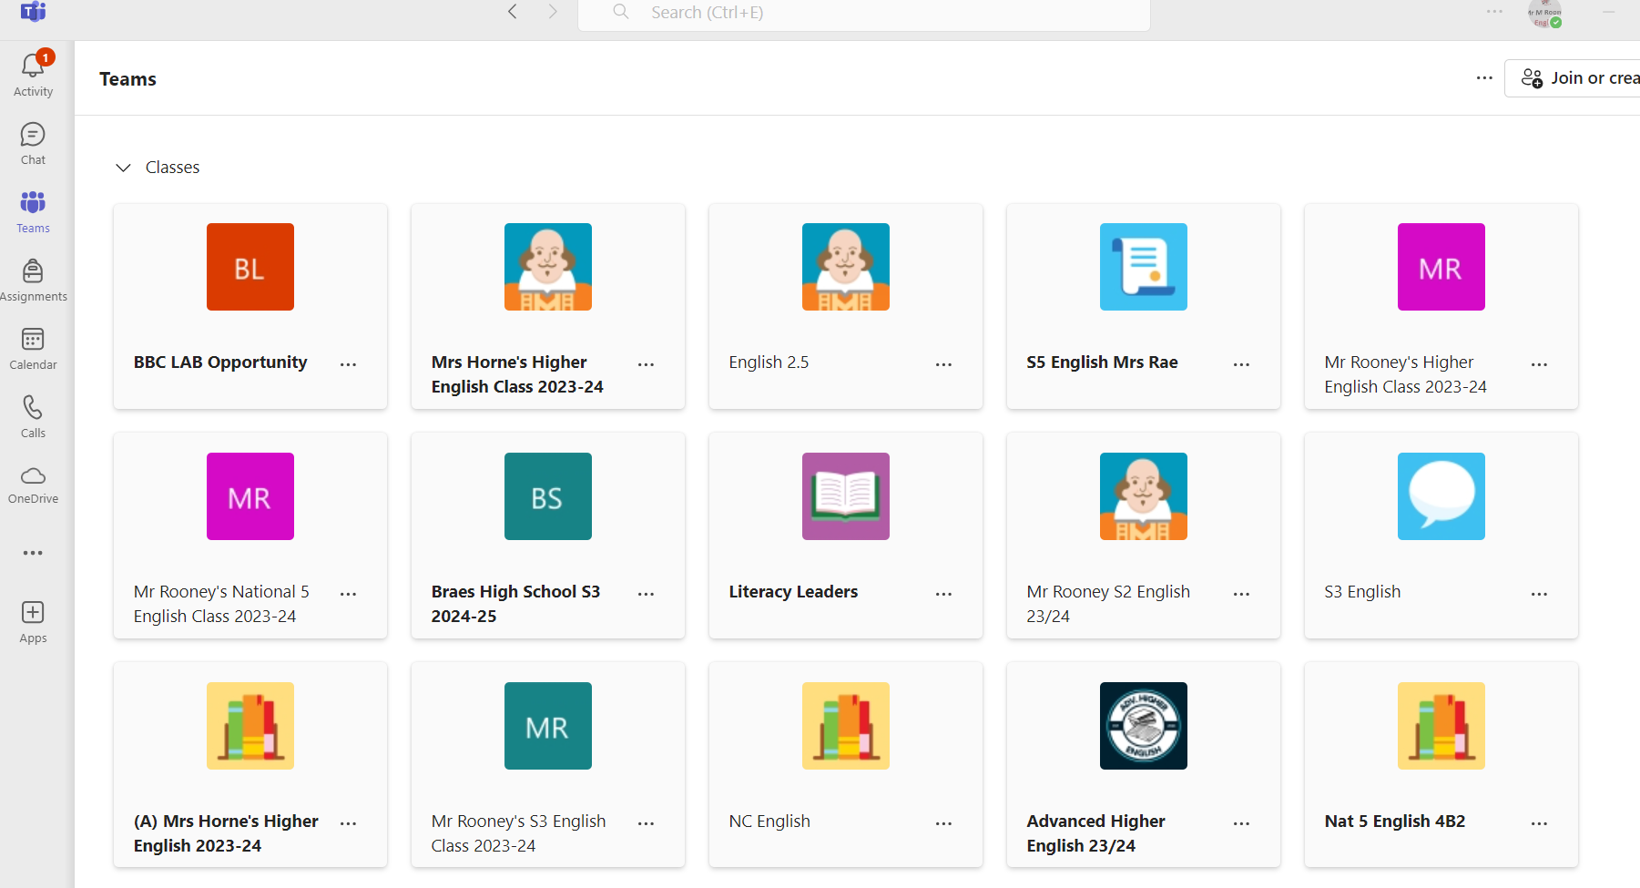
TEAMS

Slide 29
Faculty Help and resources
Open door policy within the faculty
After school revision sessions / Study Support Wednesday Afternoon/Study Camp/Easter School
Twitter @BraesENG_Media
Mark.rooney@education.falkirk.sch.uk

